Slide 1
WELCOME TO OUR PRESENTATION

Slide 2
PRESENTED BY:-
ARYAN KESHARWANI - (0608CS201008)
MONIKA CHAUDHARY - (0608CS201031)
SIDDHI NEMA - (0608CS201059)
KSHITIJ SONI - (0608CS201026)
(B.TECH COMPUTER SCIENCE SEM-5)

Slide 3
TIC-TAC-TOE GAME

Slide 4
CONTENTS :-
Introduction to tic – tac – toe .
Functions .
Header files .
Game interface .
Sample output 1 .
Sample output 2 .
Future scope .
Conclusion .
References .

Slide 5
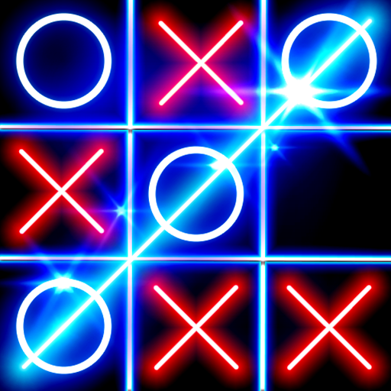
Introduction to tic-tac-toe :-
This game is very popular and is fairly simple by itself. It is actually a two player game . In this game , there is a board with n X n squares. In our game , it is 3 X 3 squares.
The goal of Tic Tac Toe is to be one of the players to get three same symbols in a row horizontally , vertically or diagonally – on a 3 X 3 grid.
In this game , players soon discover that best play from both the parties leads to a draw . Hence Tic –Tac – Toe is most often played by young children .

Slide 6
Functions :-
printInputMatrix( ) : this function prints the input matrix of 3 X 3 with having field’s name mentioned in that particular field.
printBoard( ) : this function prints the whole Tic – Tac – Toe grid of 3 X 3 .
addMark( ) : this function is used to add mark to particular fields chosen by the players .
check( ) : this function checks if any of the players has won the game or not , it is also used to check if the game is draw .

Slide 7
HEADER FILES USED IN GAME:-
#include<iostream.h> : iostream stands for standard input-output stream. This header file contains definitions of objects like cin, cout, etc.
#include<conio.h> : The conio stands for Console-Input-Output. The conio.h is a non-standard header file used in C and C++ programming. This file contains console input-output functions which are mostly used by MS-DOS compilers. This header file contains definitions of funtions like getch( ) , clrscr ( ) , etc .
using namespace std ; : a namespace is a collection of related names or identifiers (functions, class, variables) which helps to separate these identifiers from similar identifiers in other namespaces or the global namespace.

Slide 8
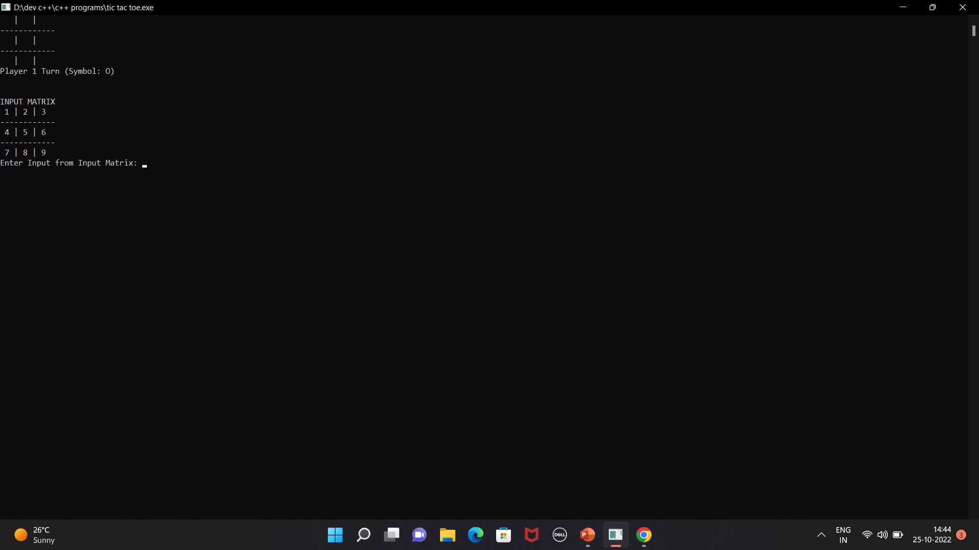
Game interface :-

Slide 9
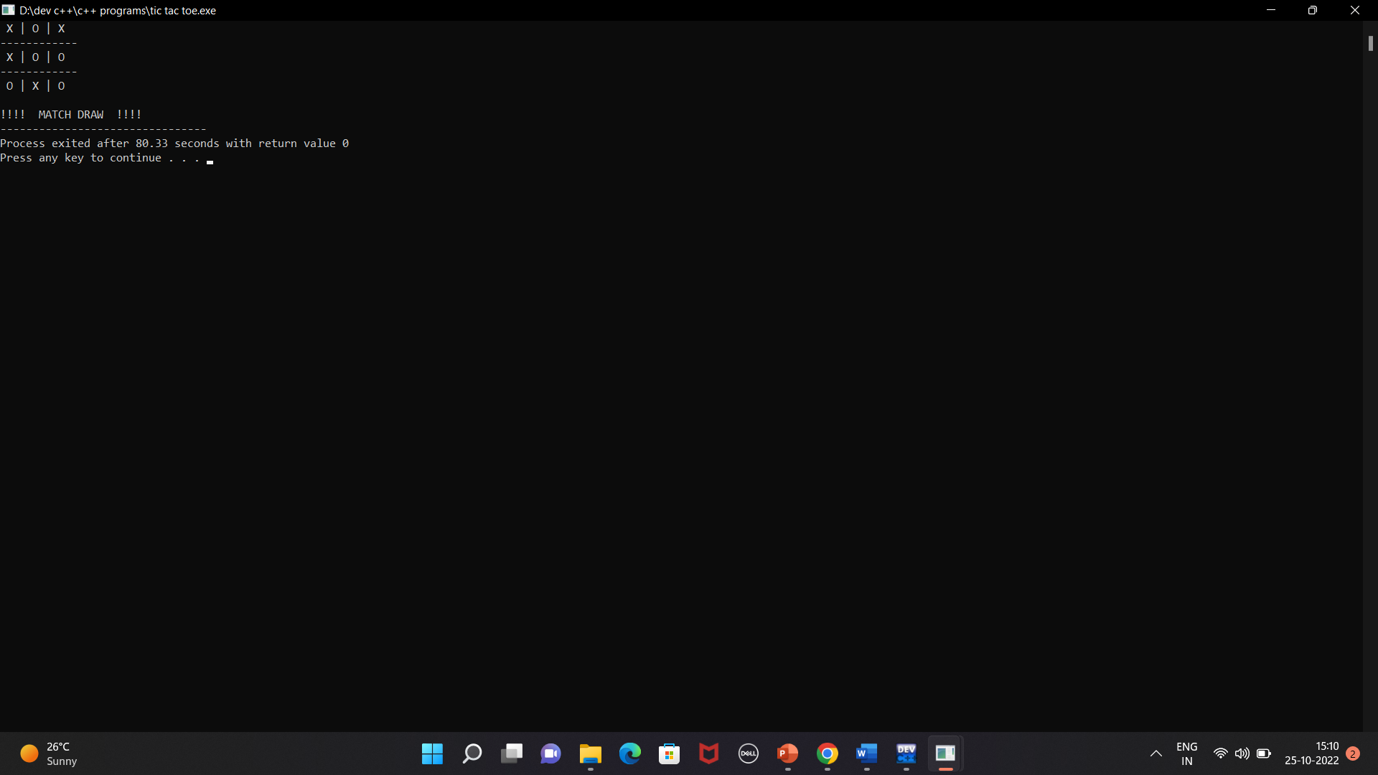
Sample output 1 :-
If the match is drawn :

Slide 10

Sample output 2 :-
If any of the player is won:

Slide 11
Future scope of the project :-
Our project will be able to implement in future after making some changes and modifications as we make our project at a very low level . So the modifications that can be done in our project are :
We can use the graphics in our project to make it look more interesting and friendly .
We can store the number of winning matches and drawn matches between the two players .

Slide 12
Conclusion :-
The Tic Tac Toe game is most familiar among all the age groups . Intelligence can be property of any purpose-driven decision maker . This basic idea has been suggested many times . An algorithm of playing Tic Tac Toe has been presented and tested that works in efficient way. Overall the system works without any bugs .

Slide 13
References :-
Geeksforgeeks : https://www.geeksforgeeks.org/c-plus-plus/ .
W3schools : https://www.w3schools.com/cpp/cpp_intro.asp .
Programiz : https://www.programiz.com/cpp-programming .

Slide 14
Thanks for listening !!

Slide 15
ANY QUERIES ?

